Slide 1
Una Europa Board
27 April 2021
Maria Gravari-Barbas, Chair, SSC CH
Notes:
Welcome
Happy that the participation is important from all the universities of Una Europa
This is an important activity today. We hope that it will contribute decisively to the development of common research activities and project implementation in our universities.
As not all of you know the activities in the focus area of Cultural heritage, let me very briefly present you a small part of our projects, on-going and future activities.

Slide 2
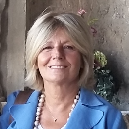
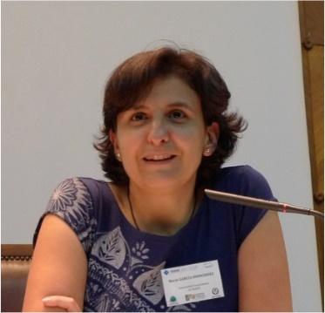
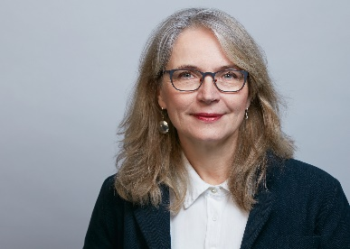
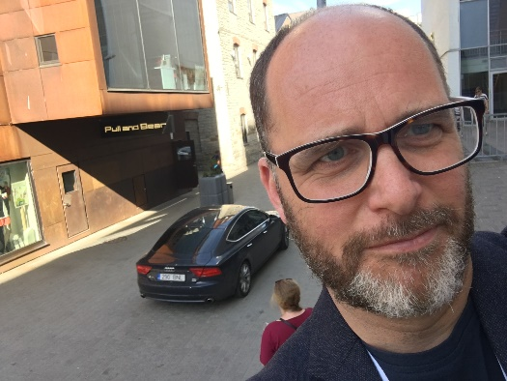
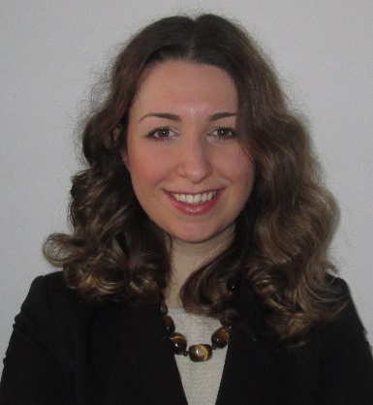
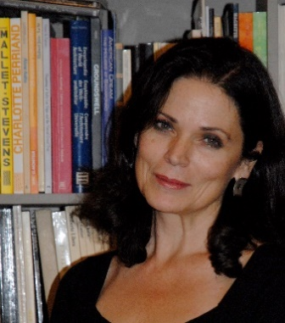
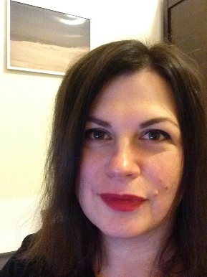
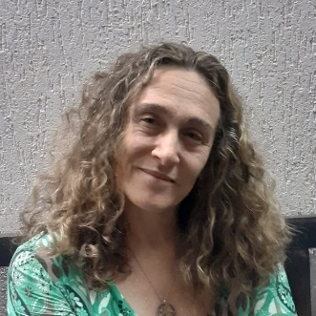
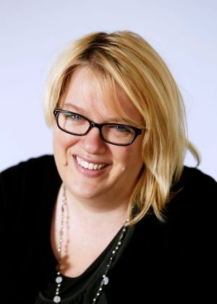
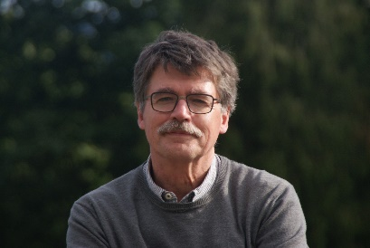
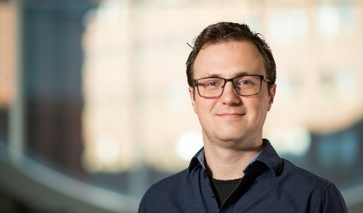
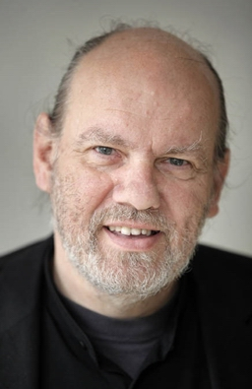
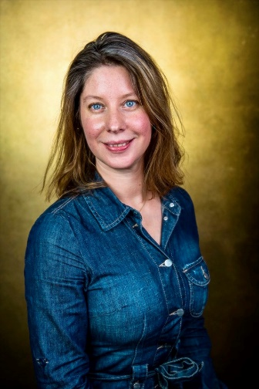
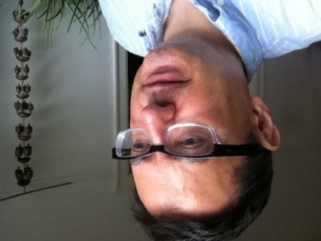
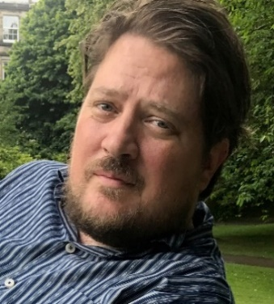
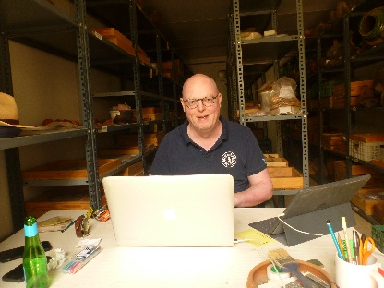
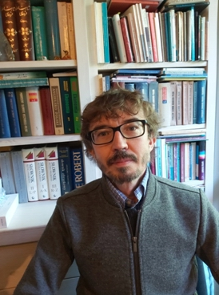
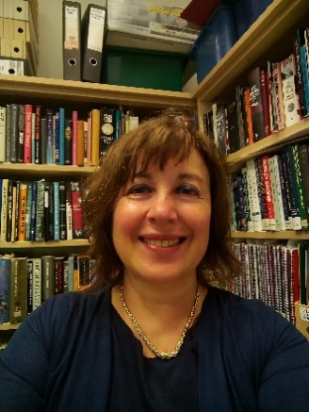
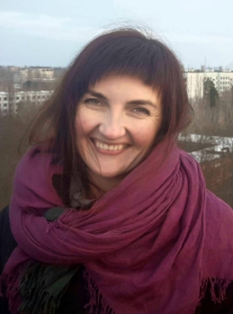
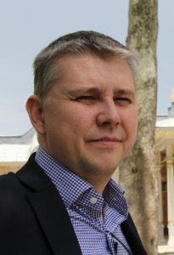
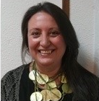
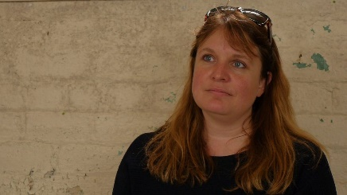
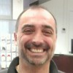
Self-Steering Committee for CH.
Chair : Paris 1 Panthéon-Sorbonne
Notes:
Let me first off all present you our SSC on Cultural heritage. It brings together researchers and professors from all universities of Una Europa and from various disciplines. One of our mail goals being to create an interdisciplinary community on Heritage studies.
The SSC meets, currently online, at least once per month. We have jointly worked on the development of the Joint format Initiatives (JIFS) on CH

Slide 3
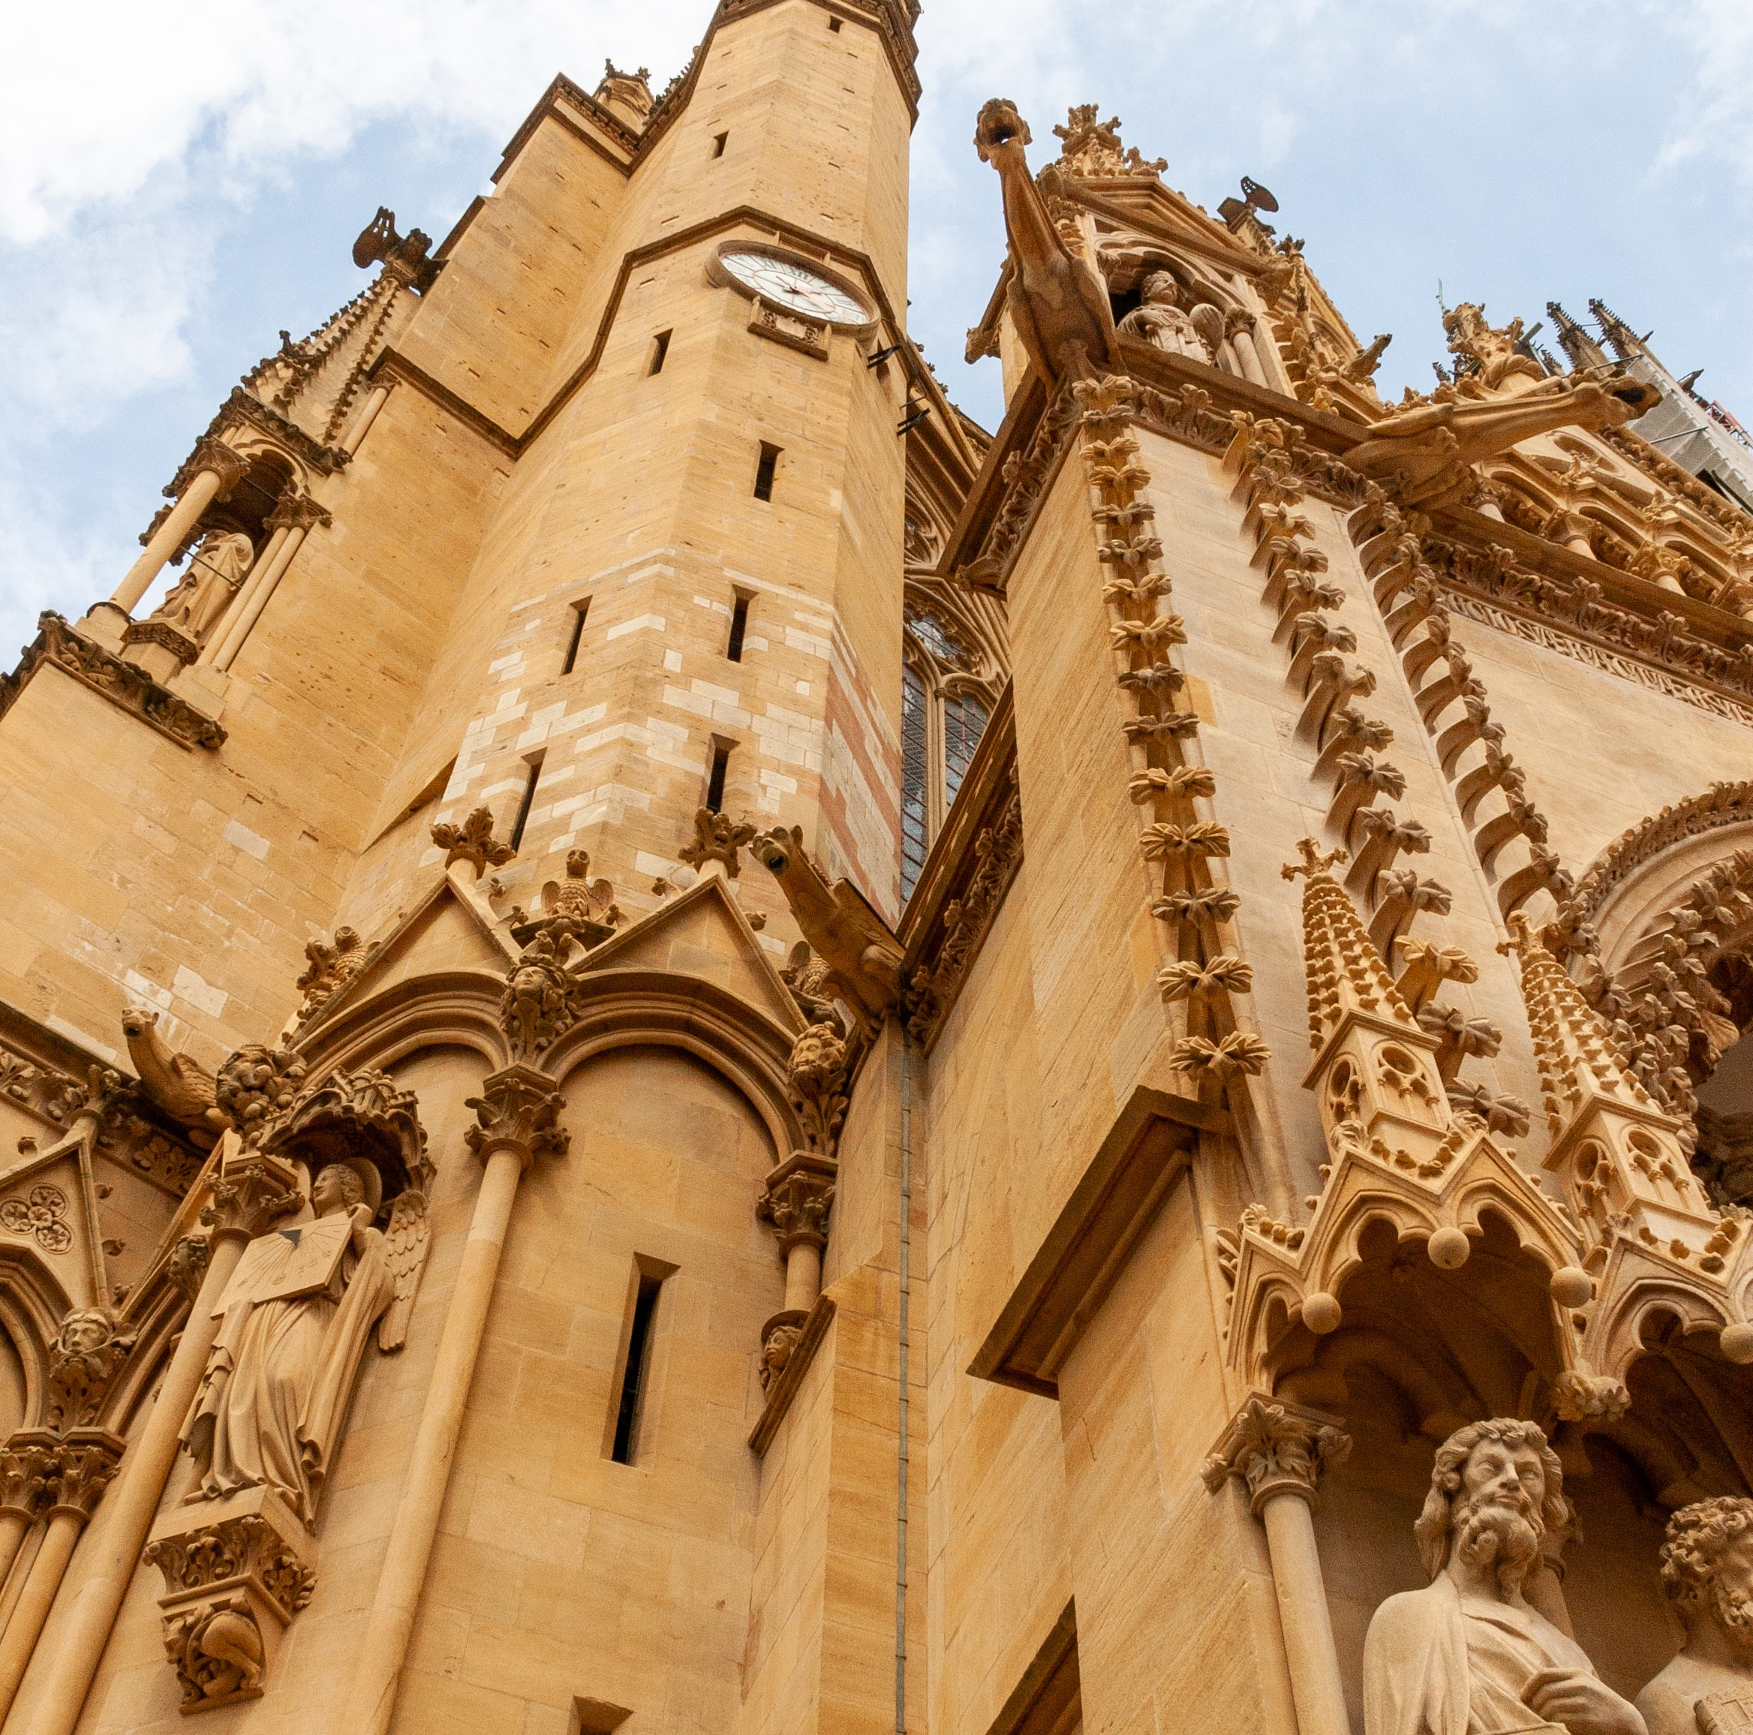
4 ‘Joint Innovative Formats’ (JIFs) for mobility and education (1Europe)
Joint/Double PhD
PhD Workshops
“Lifelong Learning Certificates”
Chair on Cultural Heritage
Notes:
Those are mainly 4:
Joint and Double PhD
PhD Workshops
“Lifelong Learning Certificates”
Chair on Cultural Heritage

Slide 4
Joint / Double PhD
2 steps-approach
1.1. Double PhD
Codirection (cotutelle) between 2 Una Europa Universities of a disciplinary PhD + Certificate on Cultural Heritage cosigned by all 8 Una Europa Universities (based on common teaching materials).
Launch: September 2021
1.2. Joint PhD on Cultural Heritage
A Joint PhD on Cultural Heritage, offered by all Una universities
Launch: September 2022
In the two cases:
Creation of a “doctoral ecosystem” (PhD cohorts; researchers + thesis supervisors' community; transnational research teams).
Notes:
The PhD is prepared as a two steps approach. At a first stage we developed a Joint certificate on Cultural Heritage. This is open to students who are in co-tutelle / co-direction in 2 una Europe universities, and in various disciplines (history, history of art, geography, anthropology, etc.). They will follow courses co-prepared by all universities, and they will receive a double doctorate from 2 universities as well as a Joint Certificate on Cultural heritage signed by all 8 universities of una Europa.
Do not hesitate to speak around you about this initiative, we will start recruiting soon!
We are also now working on a JOINT PhD on CH, to be launched in the academic year 2022-2023

Slide 5
Joint / Double PhD
The Joint/Double PhD is based on:
i) Bilateral agreements (cotutelle, signed specifically for each PhD Student)
ii) Consortium agreement (signed by all 8 universities)
The Consortium Agreement concerns the:
- a Una Europa Doctoral Programme in Cultural Heritage (Una-Her-Doc), open to Doctoral candidates who would simultaneously be enrolled in two Una Europa Universities in compliance with the national accreditation procedures, through bilateral agreements of co-supervision.
and offers:
- a Certificate “Una Europa Doctoral Programme in Cultural Heritage (Una-Her-Doc)” to Doctoral candidates who have received a double or joint doctoral degree from two Una Europa universities and have fulfilled the Una-Her-Doc programme requirements.

Slide 6
Joint/Double PhD Governance
Una-Her-Doc
coordinating university
UH
UoE
UP1
FUB
Una Europa
Board of Directors
Joint Doctoral Committee (JDC)
[(1 Chair, 8 members (1 Pr named by each university)]
Link with existing PhD
programs/Schools
KUL
UNIBO
Una-Her-Doc Steering Committee
(24 members: JDC + 8 Dir of thesis + 8 PhD Student named by each university)
UCM
JU
TRT 1
TRT 2
TRT 3
TRT 4
The Una-Her-Doc Steering Committee reflects on the general principles of the programme and has a consultative role in the Una-Her-Doc programme. The Una-Her-Doc Steering Committee is the final decision body in the Una-Her-Doc programme in case Parties do not agree with decisions of the JDC.
The JDC regularly defines the specific programme of the Una-Her-Doc programme (courses, modules, Workshops, etc.) and assesses whether the applications for the Una-Her-Doc are admissible.
4 Transnational Research Teams

Slide 7
Framework of the study programme
The framework of the study programme contains:
Co-supervision by two co-supervisors in two Una Europa universities.
Annual presentation of the progress to the Cultural Heritage expert Committee.
12-months (cumulative) mobility to the Host university.
Possibility of additional mobility within the Consortium or outside, including internship.
Possibility of teaching experience.
Active participation in one of the Una Europa research teams.
Mandatory & elective courses.
.

Slide 8
A Student-centered approach…
PhD
Supervisor
U1
PhD
Supervisor
U2
PhD Workshop
PhD seminars
PhD Master Classes
UNA Europa
CH
PhD Student
Una-Her-Doc
Cultural
Heritage
Expert Committee
Blended interdisciplinary “project workshops” and Summer Camps
Mobility
TRT 1
TRT 2
TRT 3
TRT 4
Language Classes
Transnational Research Teams

Slide 9
Una-Her-Doc Ecosystem
PIs &
PhD SUPERVISORS
PhD STUDENTS
COHORTS
Una-Her-Doc
ecosystem
RESEARCH TEAMS
Jointly produced Teaching material
& activities

Slide 10
Common materials (created by 8 universities)
Mandatory contents
Methodology seminars
Introductory “founding theories” seminars
PhD Workshop
Research Teams seminars
Language classes
Pre-defense in front of the Advisory Committee
Elective contents
PhD Master Class – given by the Una Europa Chair on CH (JIF).
Summer Camps – PhD students working on a common project, managed by a Una Europa professor, for several weeks.
Blended interdisciplinary “project workshops” – PhD students working together on a project ideally connected to a “command” by cultural institutions/local authorities/enterprises.
Professional Certificate – PhD students to choose from the created professional certificates (JIF)

Slide 11
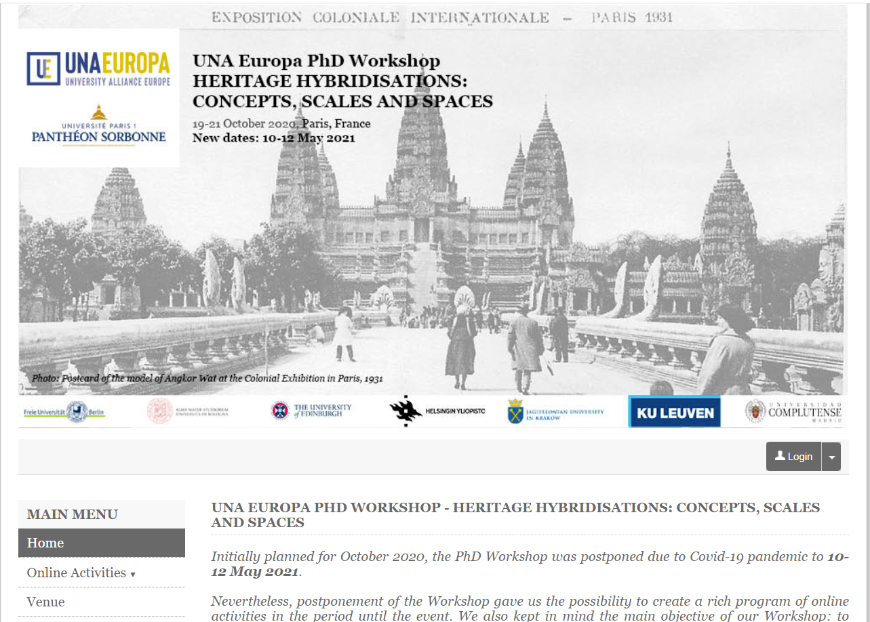
PhD Workshops
https://heritage-hybrid.sciencesconf.org/
1. HERITAGE HYBRIDISATIONS: CONCEPTS, SCALES AND SPACES (Paris 1 Panthéon-Sorbonne, May 2021)
2. Dissonant heritage: concepts, critics, cases, enhancement (Jagellonian University + Bologna University, November 2021)
3. The Politics of Cultural Heritage, Commemoration and Remembering – KU Leuven (2022)
4. Inclusion, innovation and reach: researching digital cultural heritage futures – University of Edinburgh & Helsingin Yliopisto (2022)
5. Transnational Heritage, Berlin (Autumn 2022)
Notes:
In the framework of the PhD we are also developing PhD Workshops.
5 WS are scheduled between now and 2022, which will represent an important activity and will offer opportunities to all our PhD Students to participate. The first WS will take place in 2 weeks, organised by Paris 1, and the second, co-organized by Bologna and JU is scheduled in November. 3 others, offering totally interdisciplinary approaches, will be organized in the coming months by KU Leuven, Edinburg and Helsinki Jointly, and Berlin.

Slide 12
Language policy
The courses offered by the Una-Her-Doc study programme are taught in English. However, Doctoral candidates can follow courses offered in other languages at the universities in which they have registered.
The PhD thesis can be written and defended, after explicit agreement between the relevant authorities of the two co-supervising universities and mentioned in the bilateral co-supervision agreement, in one of the languages of these universities.
(in this case, a 20-30 pages summary in English is provided).
.

Slide 13
Development of interdisciplinary transnational research teams - TRT
4 themes defined after consultation of colleagues in all universities and mapping
  1. Heritage, Global Migration and Mobility
  2. Heritage and the digitization of Society
  3. Social Capital, Mutuality and Volunteering
  4. Safeguarding Cultural Heritage
Up to now: approx. 115 researchers from different disciplines and all Una Europa universities
Notes:
Coming closer to the pint of our WS together, let me present briefly the ongoing initiative of creation of Transnational Research Teams. This is an initiative started more than one year ago. We did an mapping of the themes on which work our colleagues in our universities and after cross analysis we formulated these 4 themes.
We that wrote short texts (one-pagers) on each of these themes in order to recruit, as largely as possible, colleagues from our 8 universities.

Slide 14
Thank you!
Notes:
We remain of course at your disposal for any additional information you may need. Do not hesitate to contact us if you want to participate more actively to the SSC CH projects.

